Slide 1
Computer Networks
By
Lt Col Ishtiaq Kiani
(10 Sep 12 to 12 Jan 13)

Slide 2
PART 3
Data Link Layer

Slide 3
Chapter 12 Multiple Access
Random Access
Control Access
Channelization

Slide 4
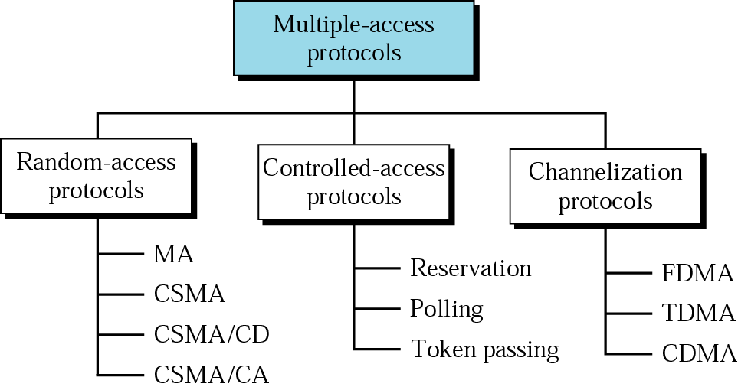
Multiple Access Protocols

Slide 5
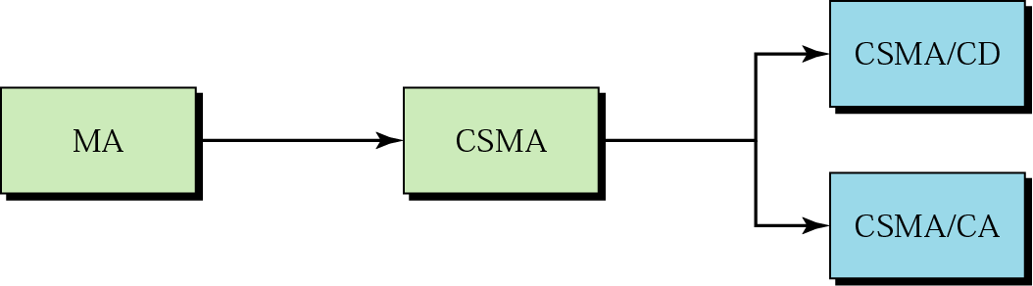
Random Access
Evolution of Random Access Methods

Slide 6
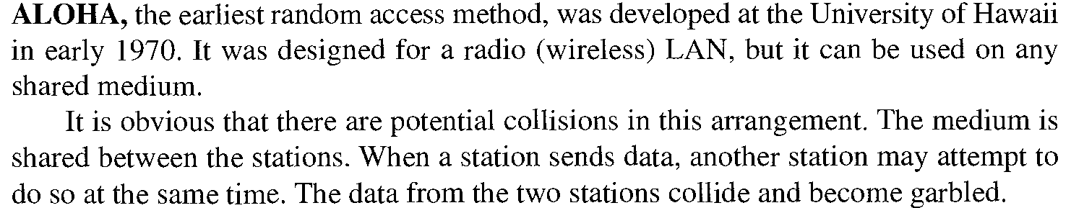
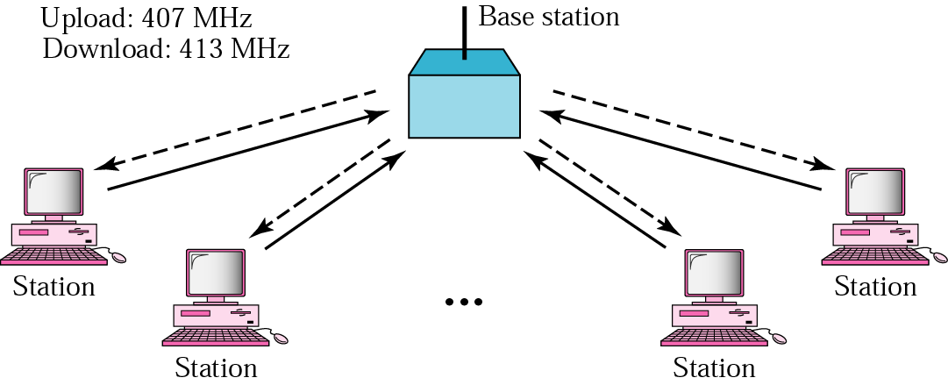
Random Access
MA – ALOHA

Slide 7
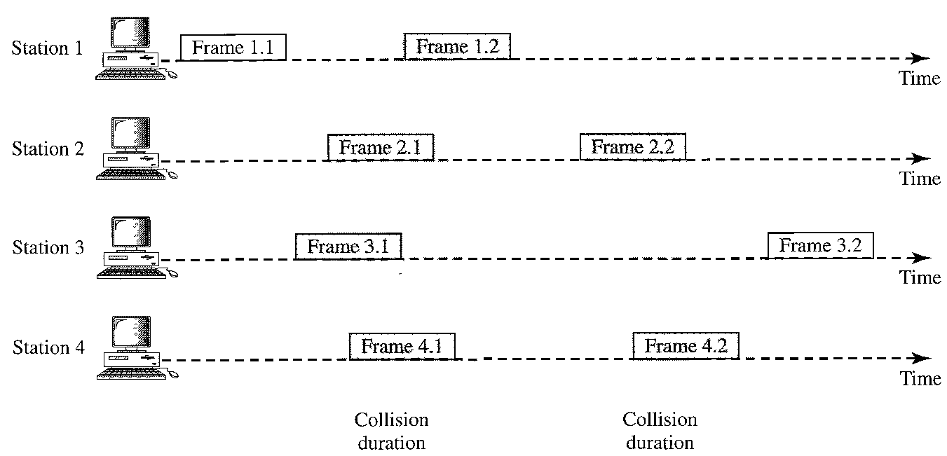
Random Access
Collision in ALOHA

Slide 8
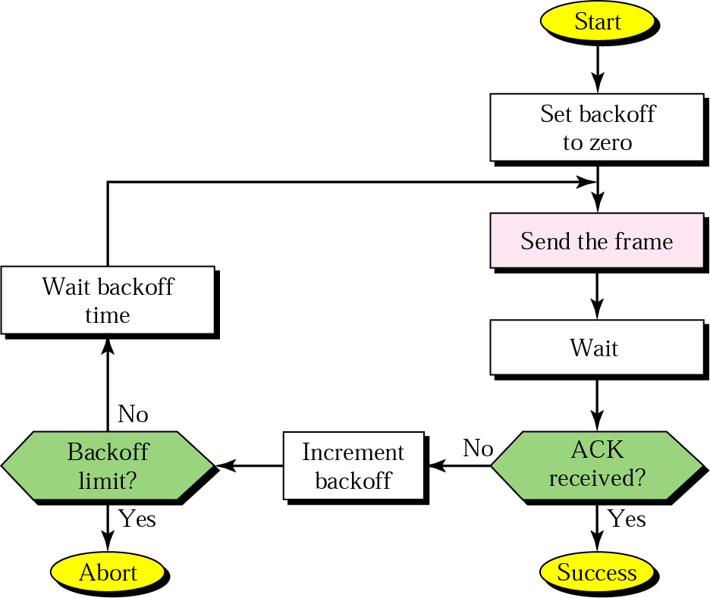
Random Access
Procedure for ALOHA Protocol

Slide 9
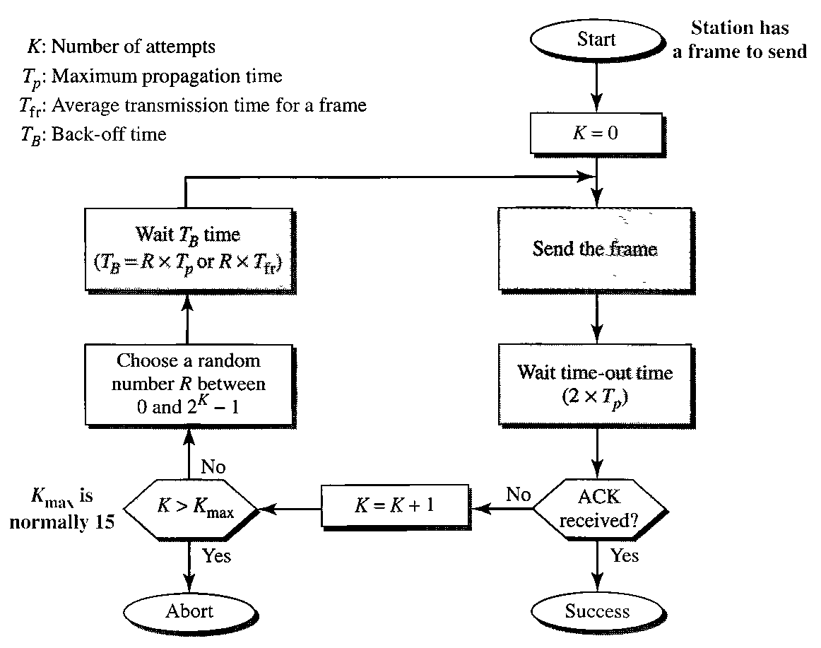
Random Access
Procedure for ALOHA Protocol

Slide 10
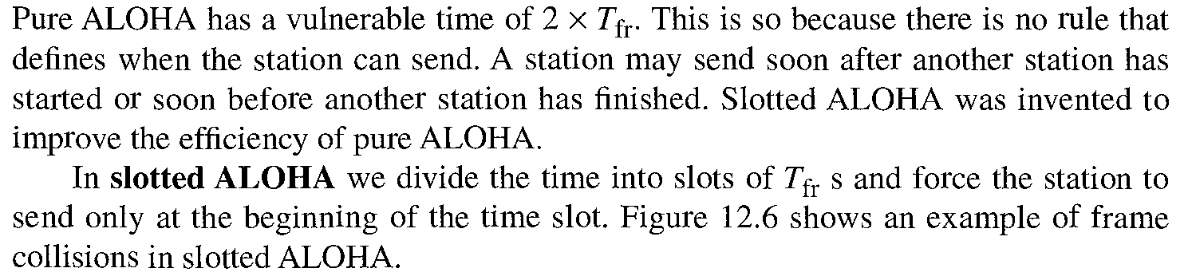
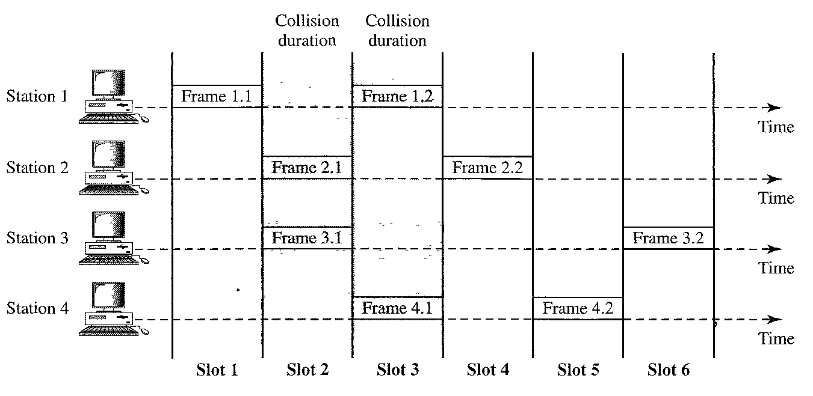
Random Access
Slotted ALOHA

Slide 11
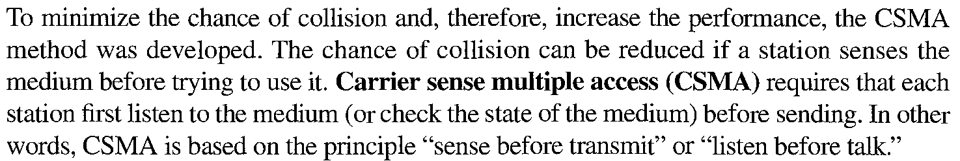
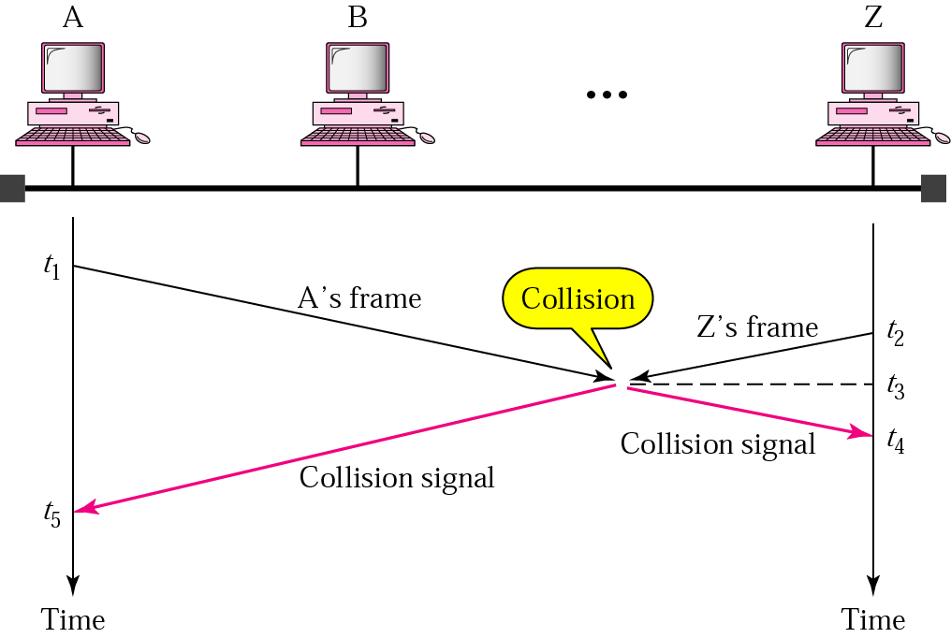
Random Access
CSMA

Slide 12
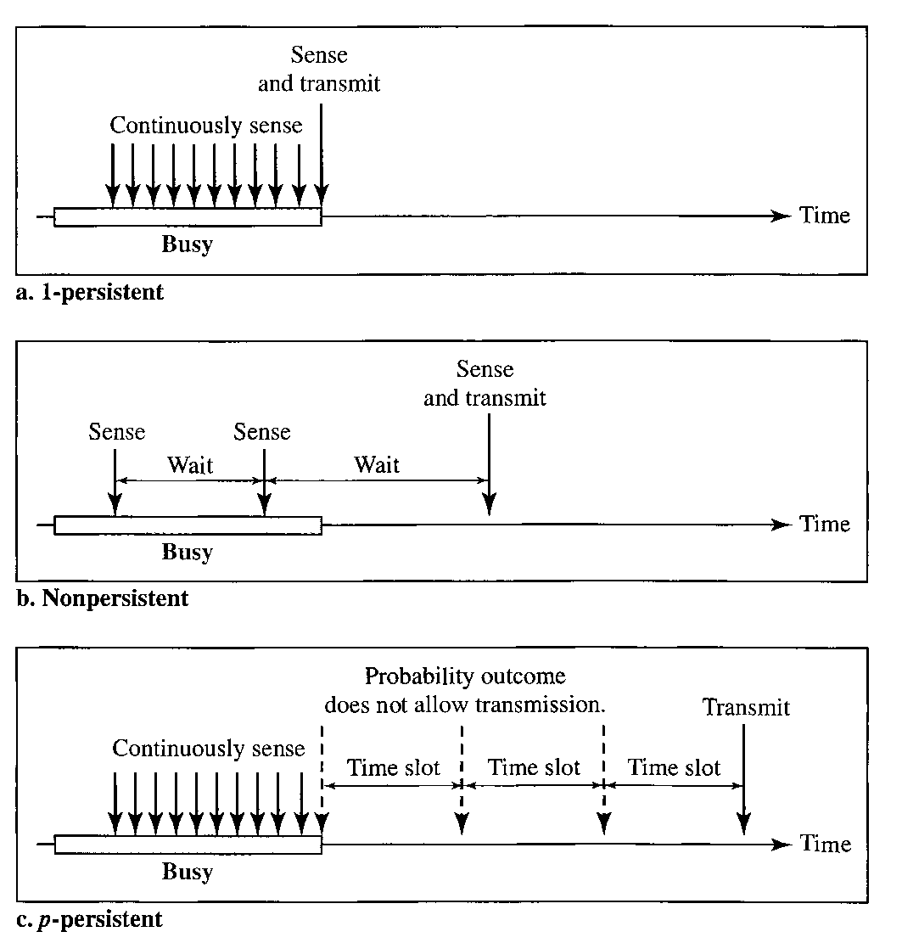
Random Access
CSMA – Persistence Methods

Slide 13
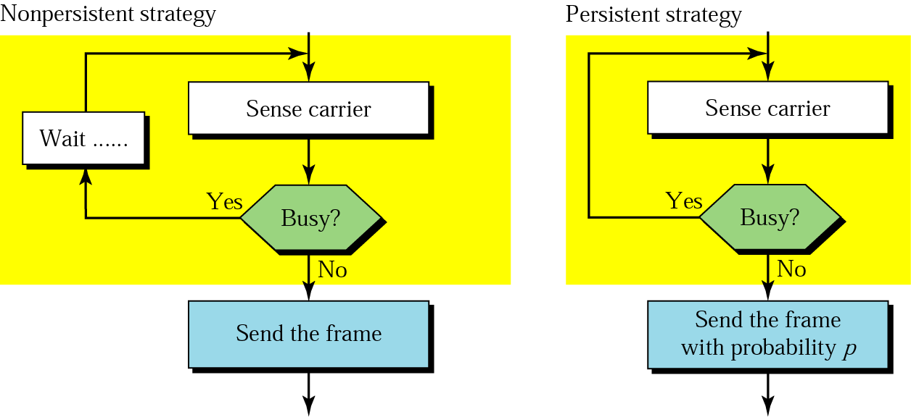
Random Access
CSMA – Persistence Methods

Slide 14
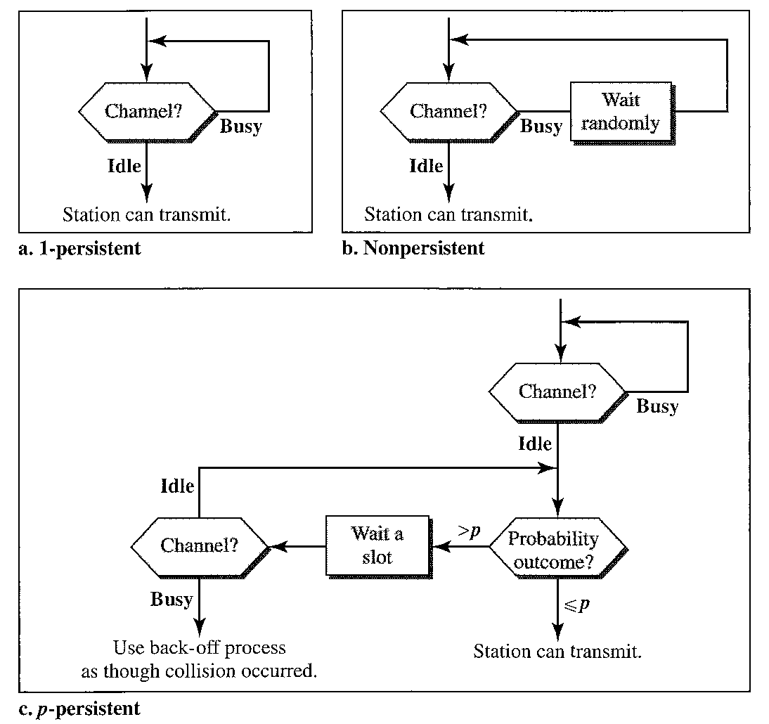
Random Access
CSMA – Persistence Methods

Slide 15
Random Access
CSMA/ CD
CSMA/CD (carrier sense multiple access with collision detection) media access protocol is used.
Data is transmitted in the form of packets.
Sense channel prior to actual packet transmission.
Transmit packet only if channel is sensed idle; else, defer the transmission until channel becomes idle.
After packet transmission is started, the node monitors its own transmission to see if the packet has experienced a collision.
If the packet is observed to be undergoing a collision, the transmission is aborted and the packet is retransmitted after a random interval of time using Binary Exponential Backoff algorithm.

Slide 16
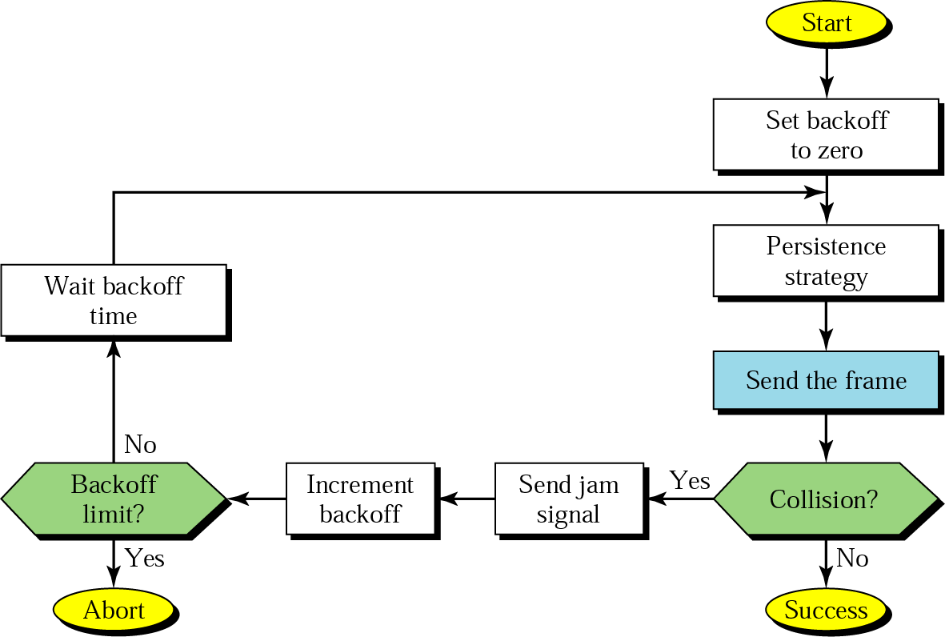
Random Access
CSMA/ CD

Slide 17
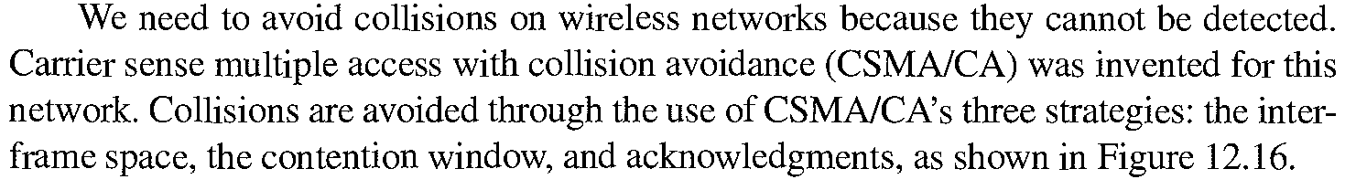
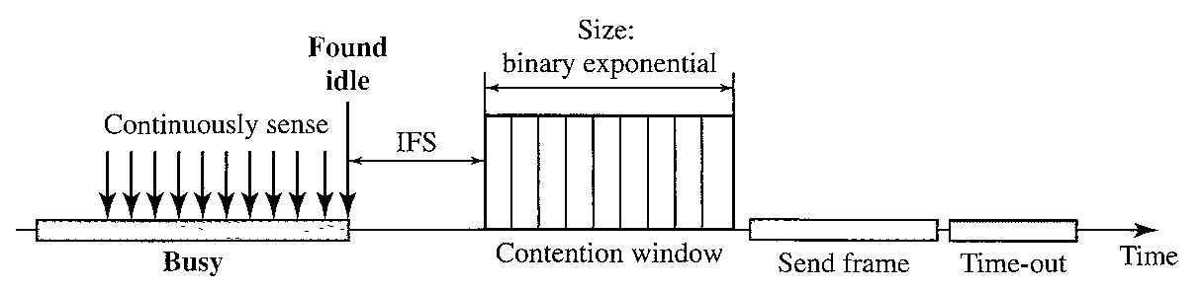
Random Access
CSMA/ CA

Slide 18
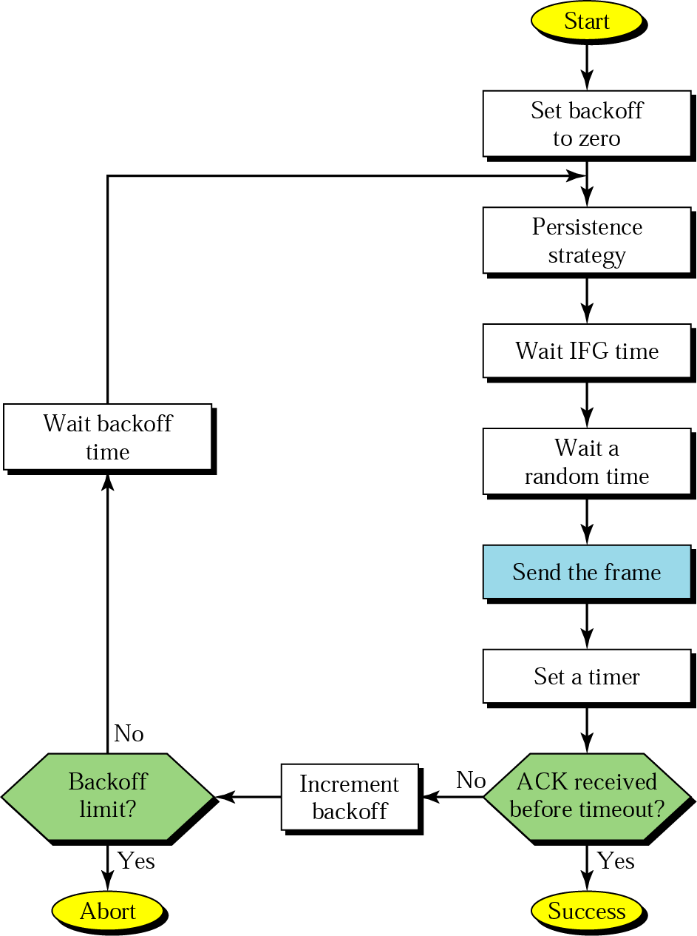
Random Access
CSMA/ CA

Slide 19
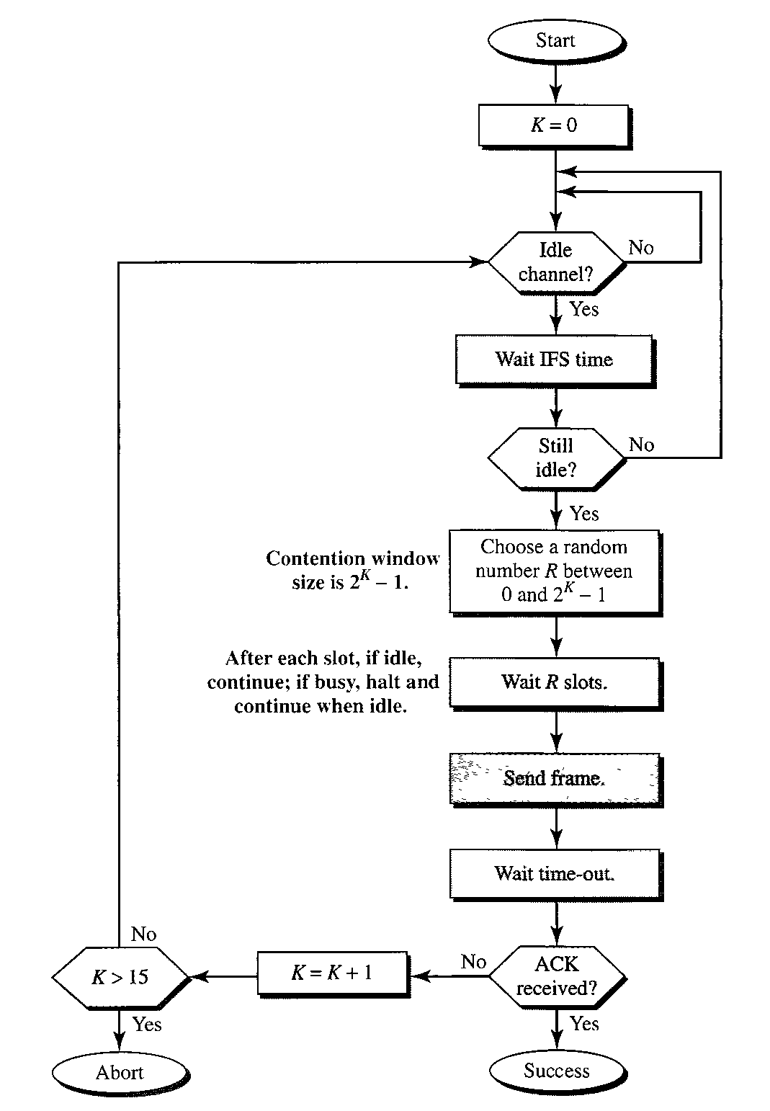
Random Access
CSMA/ CA

Slide 20
Control Access
Types
Reservation
Polling
Token Passing

Slide 21
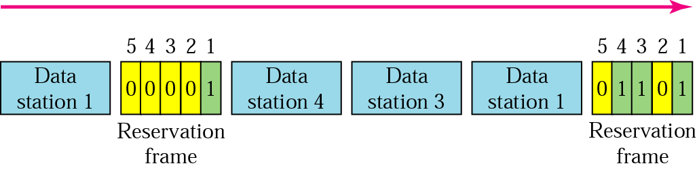
Control Access
Reservation

Slide 22
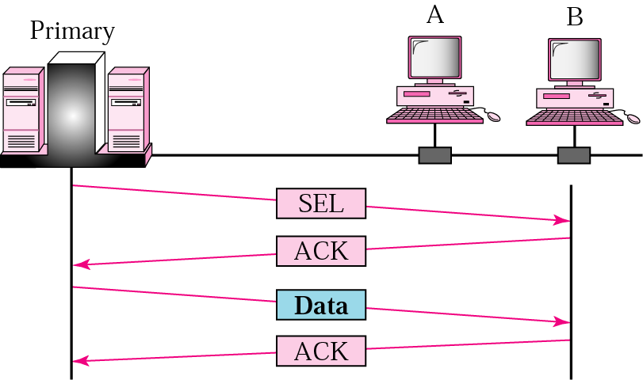
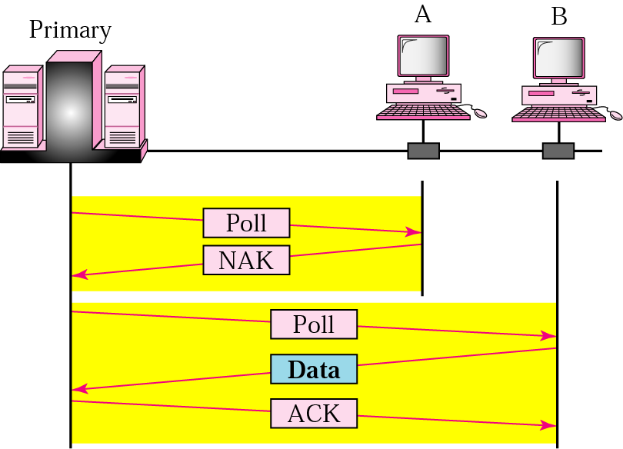
Control Access
Polling

Slide 23
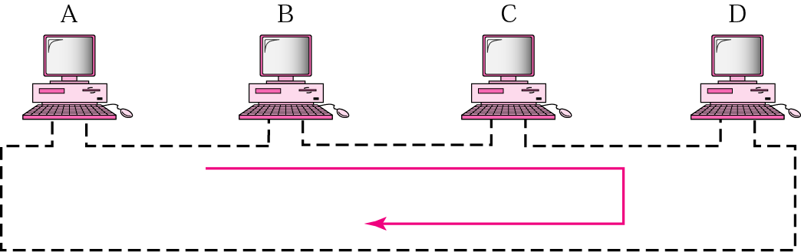
Control Access
Token Passing

Slide 24
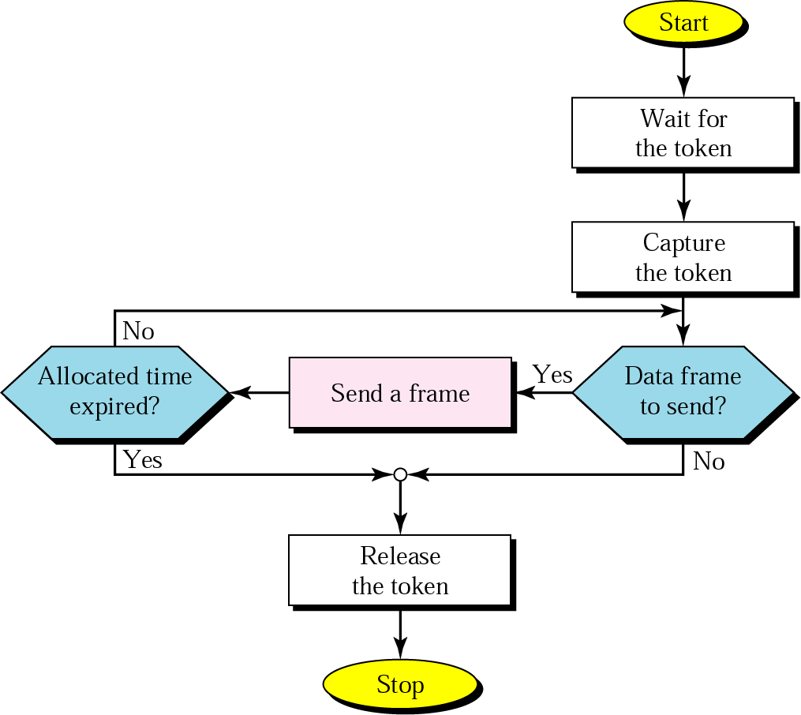
Control Access
Token Passing

Slide 25
Channelization
Types
FDMA
TDMA
CDMA

Slide 26
Channelization
Multiple Access Schemes
FDMA
power
TDMA
frequency
time
power
CDMA
frequency
time
power
frequency
time

Slide 27
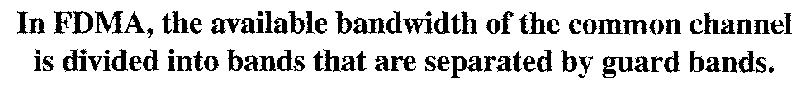
Channelization
FDMA
In FDMA, the bandwidth is divided into channels.
Frequency
C
C
f
2
B
B
f
1
A
A
f
0
Time

Slide 28
Channelization
FDMA
In Frequency Division Multiple Access, the frequency band is divided in slots. Each user gets one frequency slot assigned that is used at will.
It could be compared to AM or FM broadcasting radio where each station has a frequency assigned. FDMA demands good filtering.

Slide 29
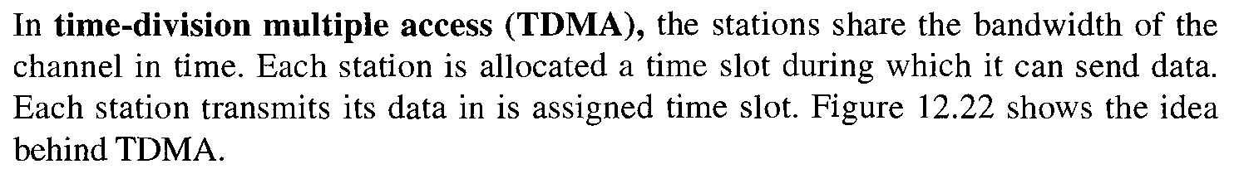
Channelization
TDMA
Frequency
A
B
f
C
B
A
C
B
A
C
B
A
C
B
A
0
C
Time
In TDMA, the bandwidth is just one channel that is timeshared.

Slide 30
Channelization
TDMA
In Time Division Multiple Access, the frequency band is not partitioned but users are allowed to use it only in predefined intervals of time, one at a time.
Thus, TDMA demands synchronization among the users.

Slide 31
Channelization
CDMA
In CDMA, one channel carries all transmissions simultaneously.
spread spectrum
Base-band Spectrum
Radio Spectrum
Code B
B
Code A
B
Frequency
Code A
A
A
B
C
B
C
B
C
A
A
A
A
B
C
B
Sender
Time
Receiver

Slide 32
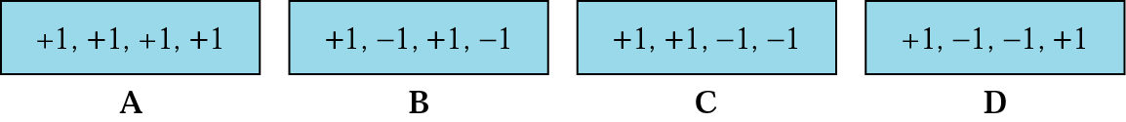
Channelization
CDMA
Codes
Encoding Rules

Slide 33
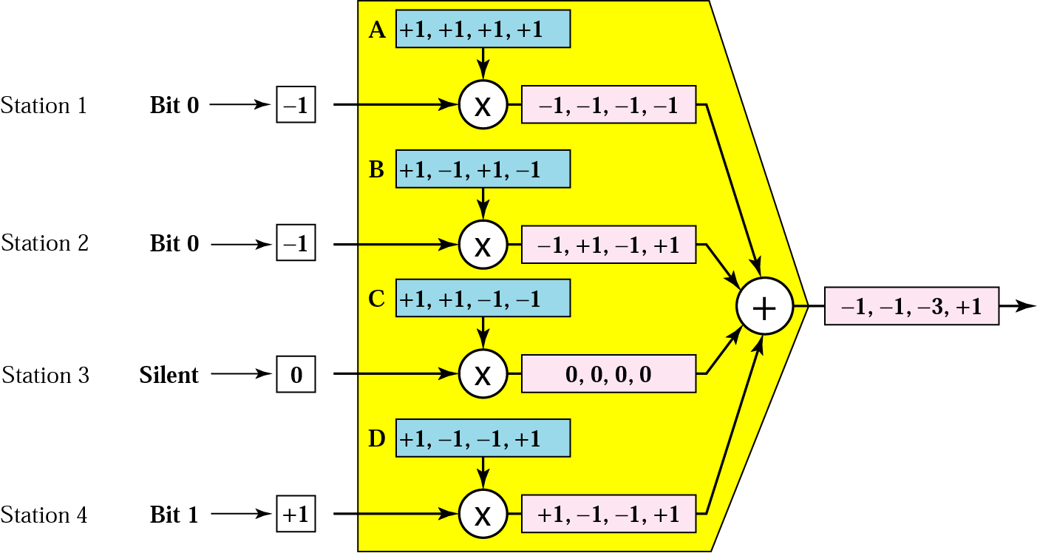
Channelization
CDMA
CDMA Multiplexer

Slide 34
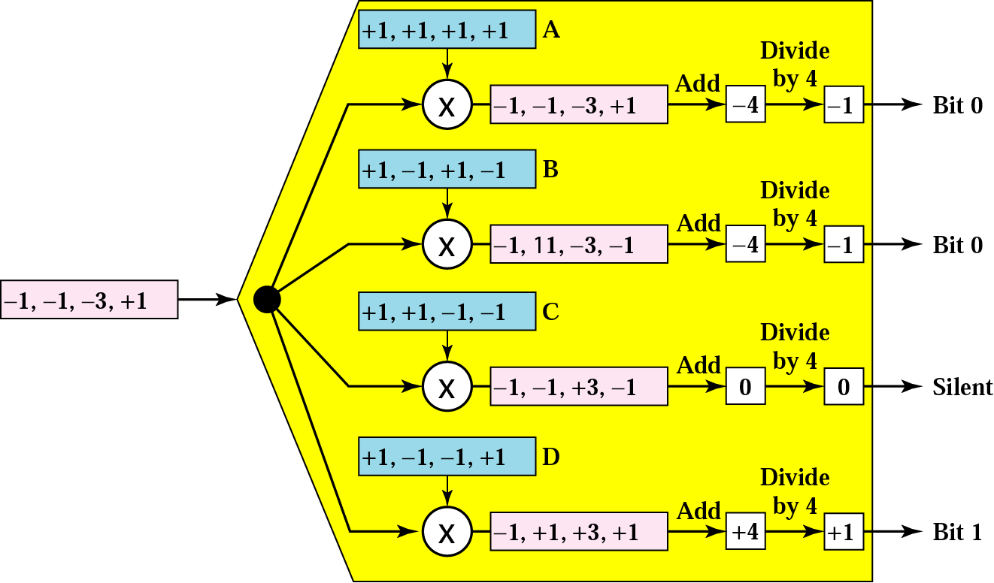
Channelization
CDMA
CDMA De-Multiplexer

Slide 35
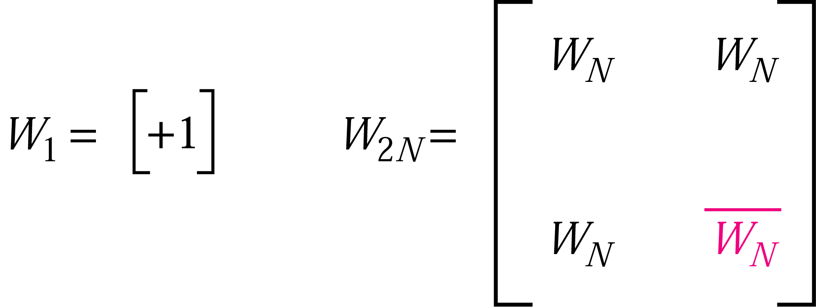
Channelization
CDMA
Walsh Codes

Slide 36
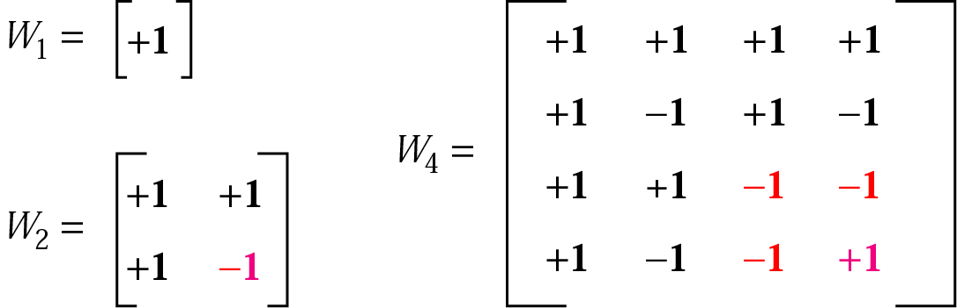
Channelization
CDMA
Walsh Codes

